Slide 1
Software Design & Architecture Software Design Principles
SESD-2222
Fall 2024
M Khizar Hayat
Khizer.hayat@ucp.edu.pk
Office: Building D Block 2nd floor
OFFICE HOURS: Tuesday : 02:00 PM- 04:00 PM
Friday: 11:00 AM- 01:00 PM

Slide 2
Design Principles
Software design principles are a set of guidelines that helps developers to make a good system design. The most important principle is SOLID principle. The key software design principles are as:
SOLID
DRY
KISS
YAGNI

Slide 3
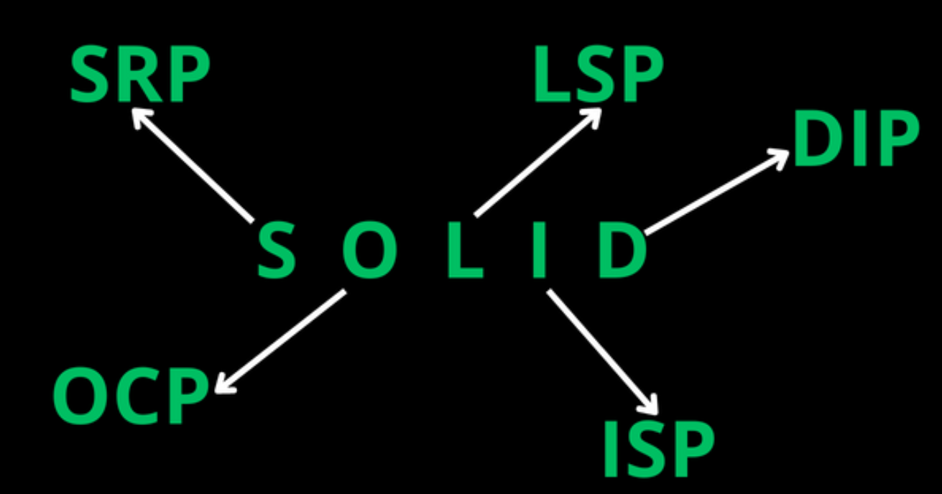

Slide 4
SOILD
It is combination of five basic designing principles.
Single Responsibility Principle (SRP)
Open/Closed Principle (OCP)
Liscov Substitution Principle (LSP)
Interface Segregation Principle (ISP)
Dependency Inversion Principle (DIP)

Slide 5
Single Responsibility Principle (SRP)
This principle states that there should never be more than one reason for a class to change. This means that you should design your classes in such a way that each class should have a single purpose.
Example - An Account class is responsible for managing Current and Saving Account but a CurrentAccount and a SavingAccount classes would be responsible for managing current and saving accounts respectively. Hence both are responsible for single purpose only. Hence we are moving towards specialization.

Slide 6
Example (SRP)
Without SRP:
A single class, User, is responsible for multiple tasks: storing user data, saving to the database, and
generating reports.
This results in a tightly coupled design, where any change to the database logic or reporting logic would
impact the User class.
With SRP:
We split the responsibilities into three separate classes:
User: Responsible for storing user data only.
UserReportGenerator: Responsible for generating user reports.
Each class now has a single, clear responsibility, making the design modular and easier to maintain.

Slide 7
Example (SRP)
For example, a class that shows the name of an animal should not be the same class that displays the kind of sound it makes and how it feeds.
To fix this, you have to create a separate class for the sound and feeding methods.

Slide 8
Open/Closed Principle (OCP)
This principle states that software entities (classes, modules, functions, etc.) should be open for extension but closed for modification. The "closed" part of the rule states that once a module has been developed and tested, the code should only be changed to correct bugs. The "open" part says that you should be able to extend existing code in order to introduce new functionality.
Example – Imagine you have a class called PaymentProcessor that processes payments for an online store. Initially, the PaymentProcessor class only supports processing payments using credit cards. However, you want to extend its functionality to also support processing payments using PayPal.
Instead of modifying the existing PaymentProcessor class to add PayPal support, you can create a new class called PayPalPaymentProcessor that extends the PaymentProcessor class. This way, the PaymentProcessor class remains closed for modification but open for extension, adhering to the Open-Closed Principle.

Slide 9
Liscov Substitution Principle (LSP)
This principle states that functions that use pointers or references to base classes must be able to use objects of derived classes without knowing it.
Example - Assume that you have an inheritance hierarchy with Person and Student. Wherever you can use Person, you should also be able to use a Student, because Student is a subclass of Person.

Slide 10
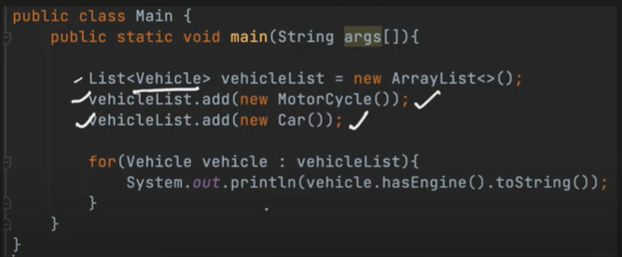
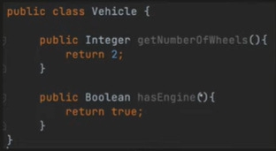
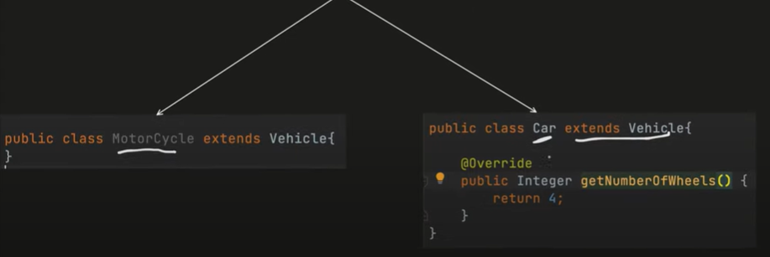
Example (LSP)

Slide 11
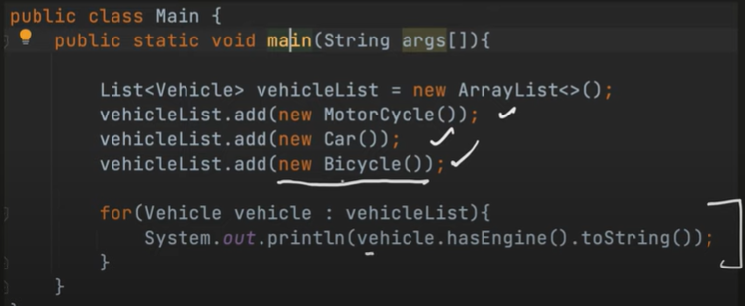
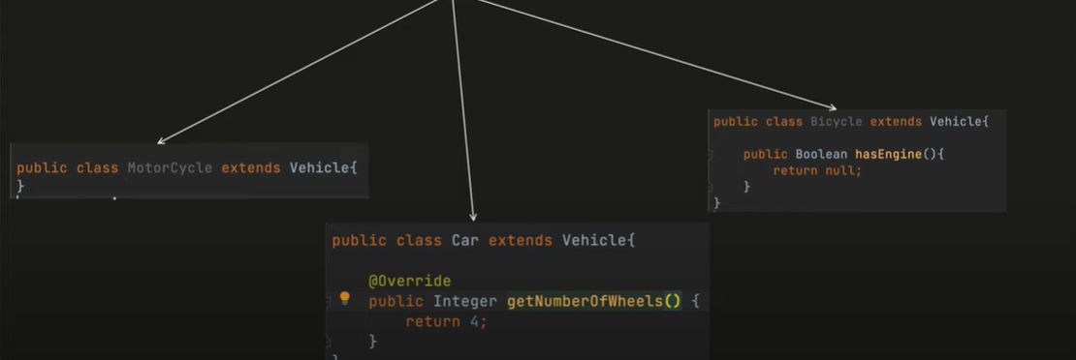

Slide 12
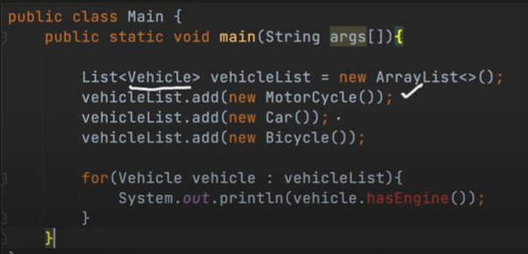
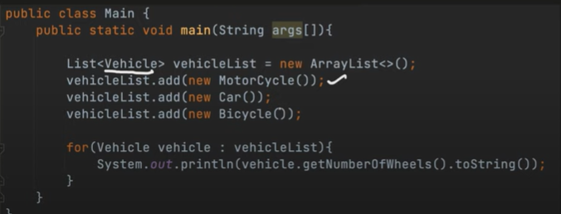
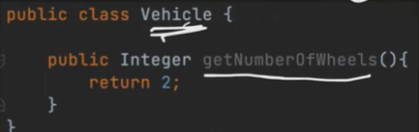
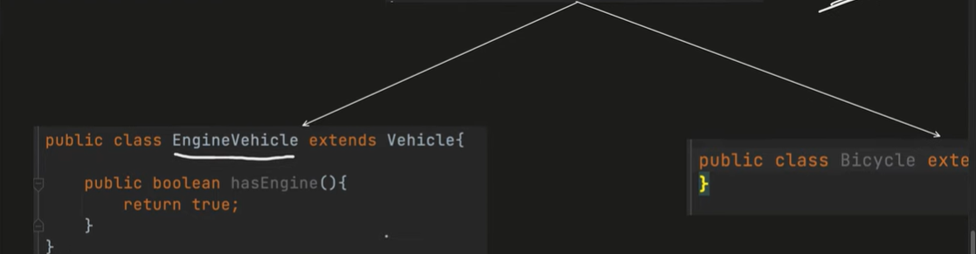
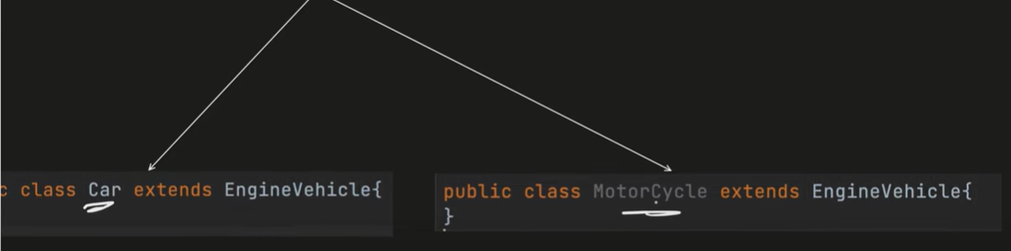

Slide 13
Interface Segregation Principle (ISP)
This principle states that Clients should not be forced to depend upon interfaces that they don’t use. This means the number of members in the interface that is visible to the dependent class should be minimized.
Rather than to design one or two more complex and fat interfaces, better to design multiple smaller interfaces.
Example - The service interface that is exposed to the client should contains only client related methods not all.

Slide 14
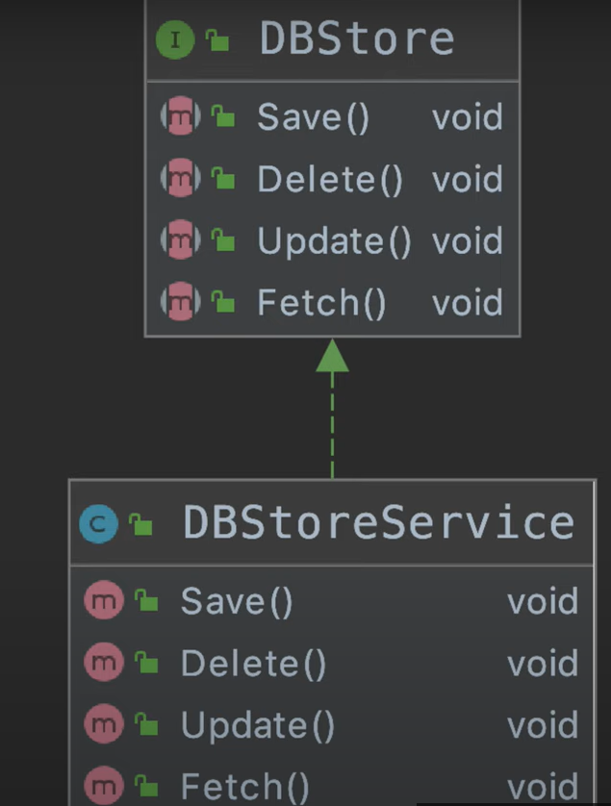
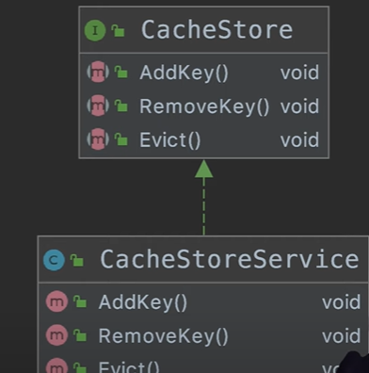
Example (ISP)

Slide 15
Dependency Inversion Principle (DIP)
The Dependency Inversion Principle states that:
High level modules should not depend upon low level modules. Both should depend upon abstractions.
Abstractions should not depend upon details. Details should depend upon abstractions.
It helps us to develop loosely couple code by ensuring that high-level modules depend on abstractions rather than concrete implementations of lower-level modules. The Dependency Injection pattern is an implementation of this principle
Example - The Dependency Injection pattern is an implementation of this principle

Slide 16
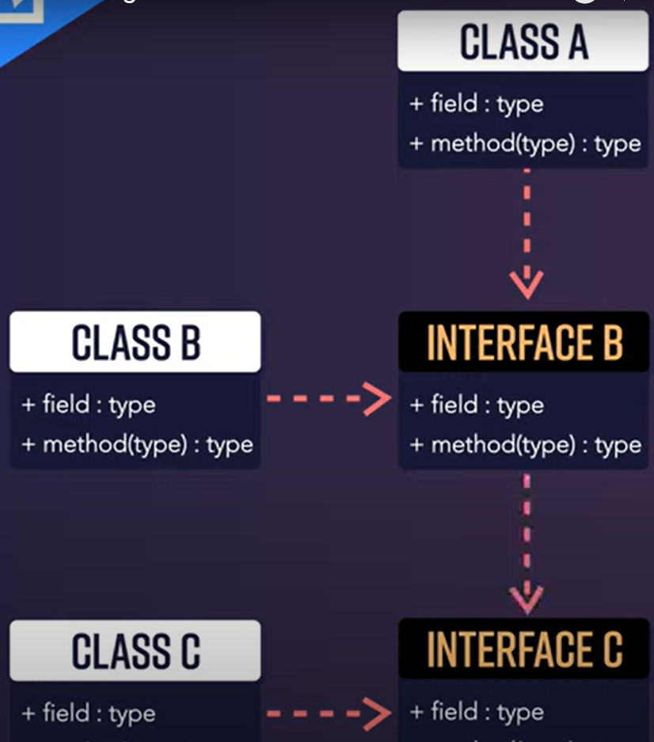
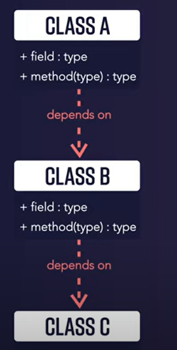
Example (DIP)

Slide 17
DRY (Don’t Repeat Yourself)
This principle states that each small pieces of knowledge (code) may only occur exactly once in the entire system. This helps us to write scalable, maintainable and reusable code.
The DRY principle emphasizes the importance of avoiding duplication in code. Duplication can lead to inconsistencies, increased maintenance effort, and a higher likelihood of introducing errors when changes are required.
To adhere to the DRY principle, developers should utilize abstractions, modularization, and reusable components to eliminate redundancy, ensuring that each piece of functionality is implemented in only one place
A simple example would be to create a function and call it from multiple locations, rather than implementing the same functionality multiple times.

Slide 18
KISS (Keep it simple, Stupid!)
This principle states that try to keep each small piece of software simple and unnecessary complexity should be avoided. This helps us to write easy maintainable code.
By keeping the design simple, developers can reduce the chances of introducing errors, improve maintainability, and make it easier for others to understand and contribute to the codebase.
KISS does not mean oversimplifying or ignoring essential requirements; instead, it suggests finding the simplest solution that meets the project’s needs

Slide 19
YAGNI (You ain't gonna need it)
This principle states that always implement things when you actually need them never implements things before you need them.
This approach encourages developers to focus on the current requirements and avoid over-engineering, which can lead to increased complexity, longer development time, and wasted effort.
Gold Platting

